Slide 1
Real Algorithm
Just started

Slide 2
Algorithm
STEP TO SOLVE PROBLEM
STEP1: ANALYS INSTRUCTION (UNDERSTAND INSTRUCTION)
STEP2: DRAW FLOW CHAT TO UNDERSTAND CODE FLOW
STEP3: WRITE CODE

Slide 3
TRY TO WRITE CODE FOLLOWING FLOWCHAT
N = 0
REPEAT<10>
IF N > 10
FALSE
PRINT(“OK”)
PRINT(“Hello”)
TRUE
PRINT(“Hello”)

Slide 4
Write code following output below
Case 1
N = INPUT
> 2
Hello
Hello
>
REPEAT<N>
Case 2
> 5
Hello
Hello
Hello
Hello
Hello
>
PRINT(“Hello”)
n=int(input())
for i in range (n):
print("Hello")

Slide 5
Write code following output below
Case 1
> 2
> 4
Result: 6
>
x=int(input())
y=int(input())
sum=x+y
print("result:"+str(sum))
Case 2
> 5
> 8
Result: 13
>

Slide 6
Write code following output below
Case 1
> 2
> 4
Result: 8
>
multiply=0
n1=int(input())
n2=int(input())
multiply=n1*n2
print("result:"+str(multiply))
Case 2
> 5
> 8
Result: 40
>

Slide 7
Write code following output below
Case 1
> 2
Result: 4
>
n=int(input())
square=n*n
print("result:"+str(square))
Case 2
> 5
Result: 25
>

Slide 8
Write code following output below
Case 1
> 2
Even number
>
x=int(input())
if x%2==0:
print("Even Number")
else:
print("Odd Number")
Case 2
> 5
Odd number
>

Slide 9
Write code following output below
Case 1
> -2
Negative number
>
x=int(input())
if x<0:
print("Negative Number")
elif x>0:
print("Positive Number")
else:
print("Center Number")
Case 2
> 5
Positive number
>
Case 3
> 0
Center number
>

Slide 10
Write code following output below
Case 1
> Hello
0
1
2
3
4
>
text=input()
for i in range(len(text)):
print(i)
> hi
0
1
>
Case 2

Slide 11
Write code following output below
Case 1
> Hello
H
e
l
l
o
>
text=input()
number=len(text)
for i in range (number):
result=text[i]
print(result)
> hi
h
i
>
Case 2

Slide 12
Write code following output below
Case 1
> Hello
MMMMM
>
text=input()
result=""
for i in range (len(text)):
result+="M"
print(result)
> hi
MM
>
Case 2

Slide 13
Write code following output below
Case 1
> Hello
A not found
>
text=input()
result=0
for i in range(len(text)):
if text[i]=="a“ or text[i]=="A":
result+=1
if result>0:
print(str(result)+"A in text")
else:
print("A not found")
> Banana
3 A in text
>
Case 2

Slide 14
Write code following output below
First number must be greater than second number
Case 1
> 1
> 4
2
3
>
n1=int(input())
n2=int(input())
while n1<(n2-1):
n1=n1+1
print(n1)
Case 2
> 3
> 9
4
5
6
7
8
>

Slide 15
Write code following output below
Case 1
n1=int(input())
n2=int(input())
n3=int(input())
if (n1>n2) and (n1>n3):
print(str(n1)+"is bigger than other")
elif (n2>n1) and (n2>n3):
print(str(n2)+"is bigger than other")
else:
print(str(n3)+"is bigger than other")
> 1
> 4
> 8
8 is bigger than other
>
Case 2
> 3
> 9
> 6
9 is bigger than other
>

Slide 16
Write code following output below
Enter 5 times and sum all numbers
Case 1
> 1
> 4
> 8
> 3
> 2
Sum: 18
>
sum=0
for i in range (5):
n=int(input())
sum+=n
print("Sum:"+str(sum))
Case 2
> 1
> 1
> 2
> 3
> 6
Sum: 13
>

Slide 17
Write code following output below
Enter until find number 7
Case 1
> 1
> 4
> 8
> 3
> 7
Good bye!
>
isSeven=False
while not isSeven:
n=int(input())
if n==7:
isSeven=True
print("Good bye!")
else:
print("Try again")
Case 2
> 1
> 1
> 7
Good bye!
>

Slide 18
Write code following output below
Enter until find number 7 display “Good bye!” otherwise display “Try again!”
Case 1
> 1
Try again!
> 3
Try again!
> 7
Good bye!
>
isSeven=False
while not isSeven:
n=int(input())
if n==7:
isSeven=True
else:
print("Try again")
print("Good bye!")
Case 2
> 1
Try again!
> 7
Good bye!
>

Slide 19
Write code following output below
Case 1
> 4
x
xx
xxx
xxxx
n=int(input())
result=""
for i in range(n):
for j in range(i+1):
result+= "x"
result+="\n"
print(result)
Case 2
> 2
x
xx

Slide 20
Write code following output below
Case 1
> 4
xxxx
xxx
xx
x
n=int(input())
result=""
for i in range(n):
for j in range(n-i):
result+="x"
result+="\n"
print(result)
Case 2
> 2
xx
x

Slide 21
Write code following output below
Case 1
> abababa
> *b*b*b*
text=input()
result=""
for i in range(len(text)):
if text[i]=='a':
result+="*"
else:
result+=text[i]
print(result)
Case 2
> acdefgaca
> *cdefg*c*

Slide 22
Write code following output below
Case 1
> abacdef
> *#*#cdef
text=input()
number=len(text)
result=""
for i in range(number):
if text[i]=='a':
result+="*"
elif text[i]=='b':
result+="#"
else:
result+=text[i]
print(result)
Case 2
> acbefbaca
> *c#ef#*c*

Slide 23
Write code following output below
Case 1
> hello
> olleh
text=input()
lastindex=len(text)-1
result=""
for i in range (len(text)):
result+=text[lastindex-i]
print(result)
Case 2
> hi
> ih

Slide 24
Write code following output below
Case 1
text=input()
print(text.upper())
> hello
> HELLO
Case 2
> HI
> HI

Slide 25
Write code following output below
Case 1
> hello
No uppercase letter
text=input()
counter=0
for i in range (len(text)):
if (text[i])==text[i].upper():
counter+=1
if counter>0:
print(str(counter)+"uppercase letters")
else:
print("No uppercase letters")
Case 2
> HI
2 uppercase letter

Slide 26
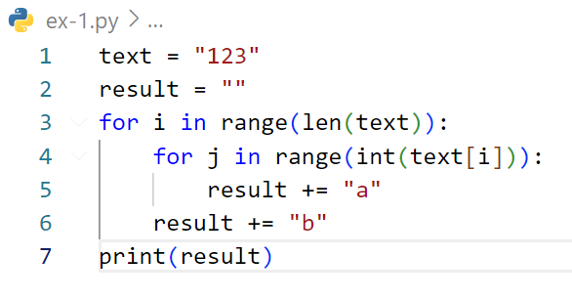
Find output of code below
abaabaaab

Slide 27
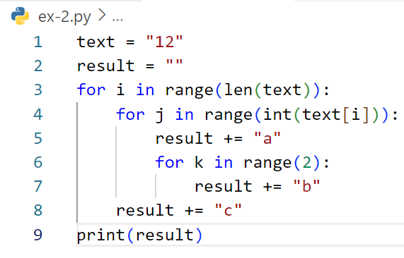
Find output of code below
abbcabbabbc

